Slide 1
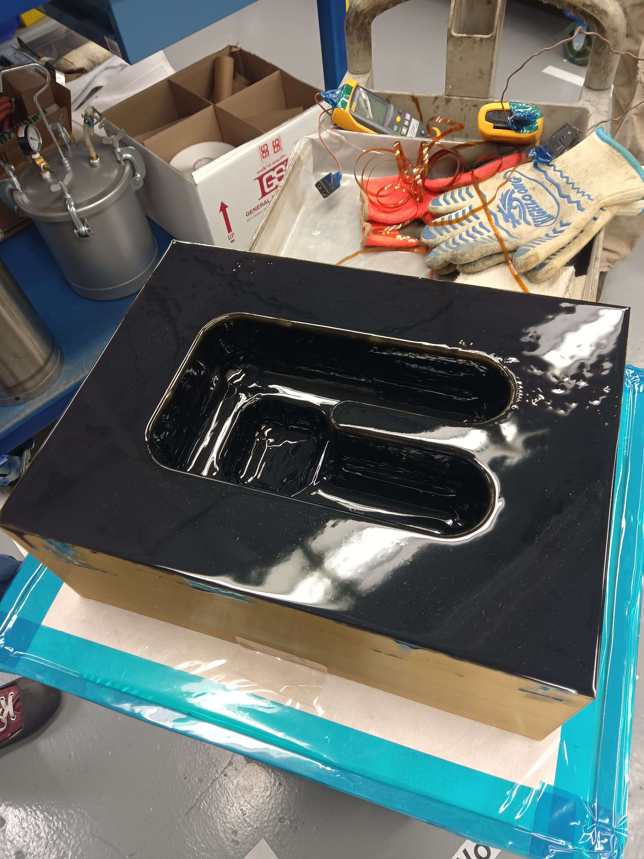
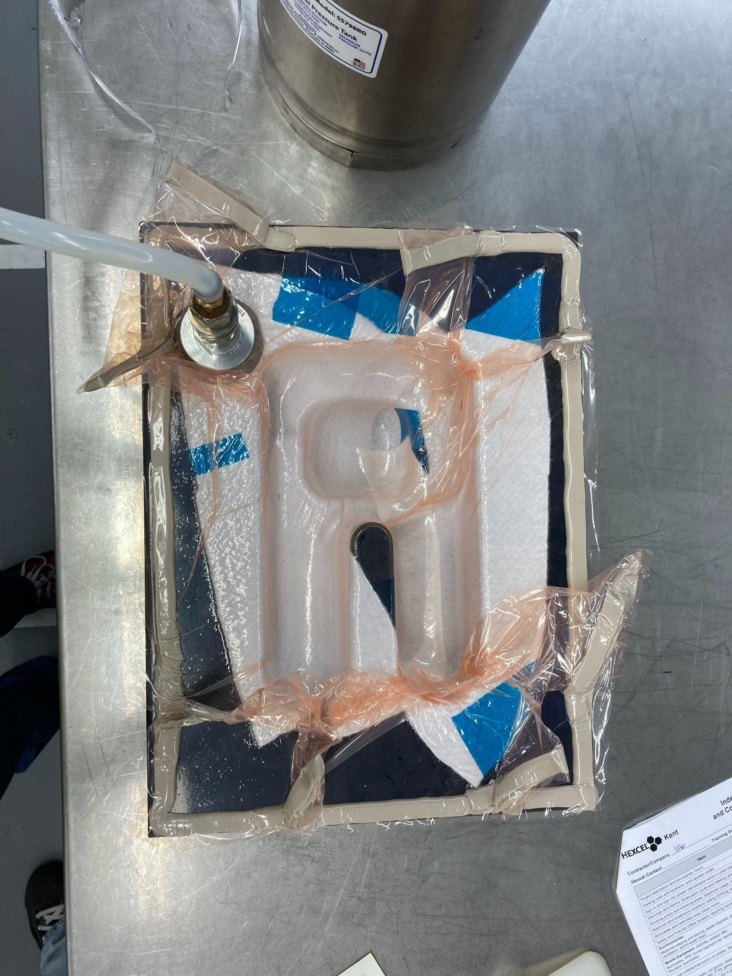
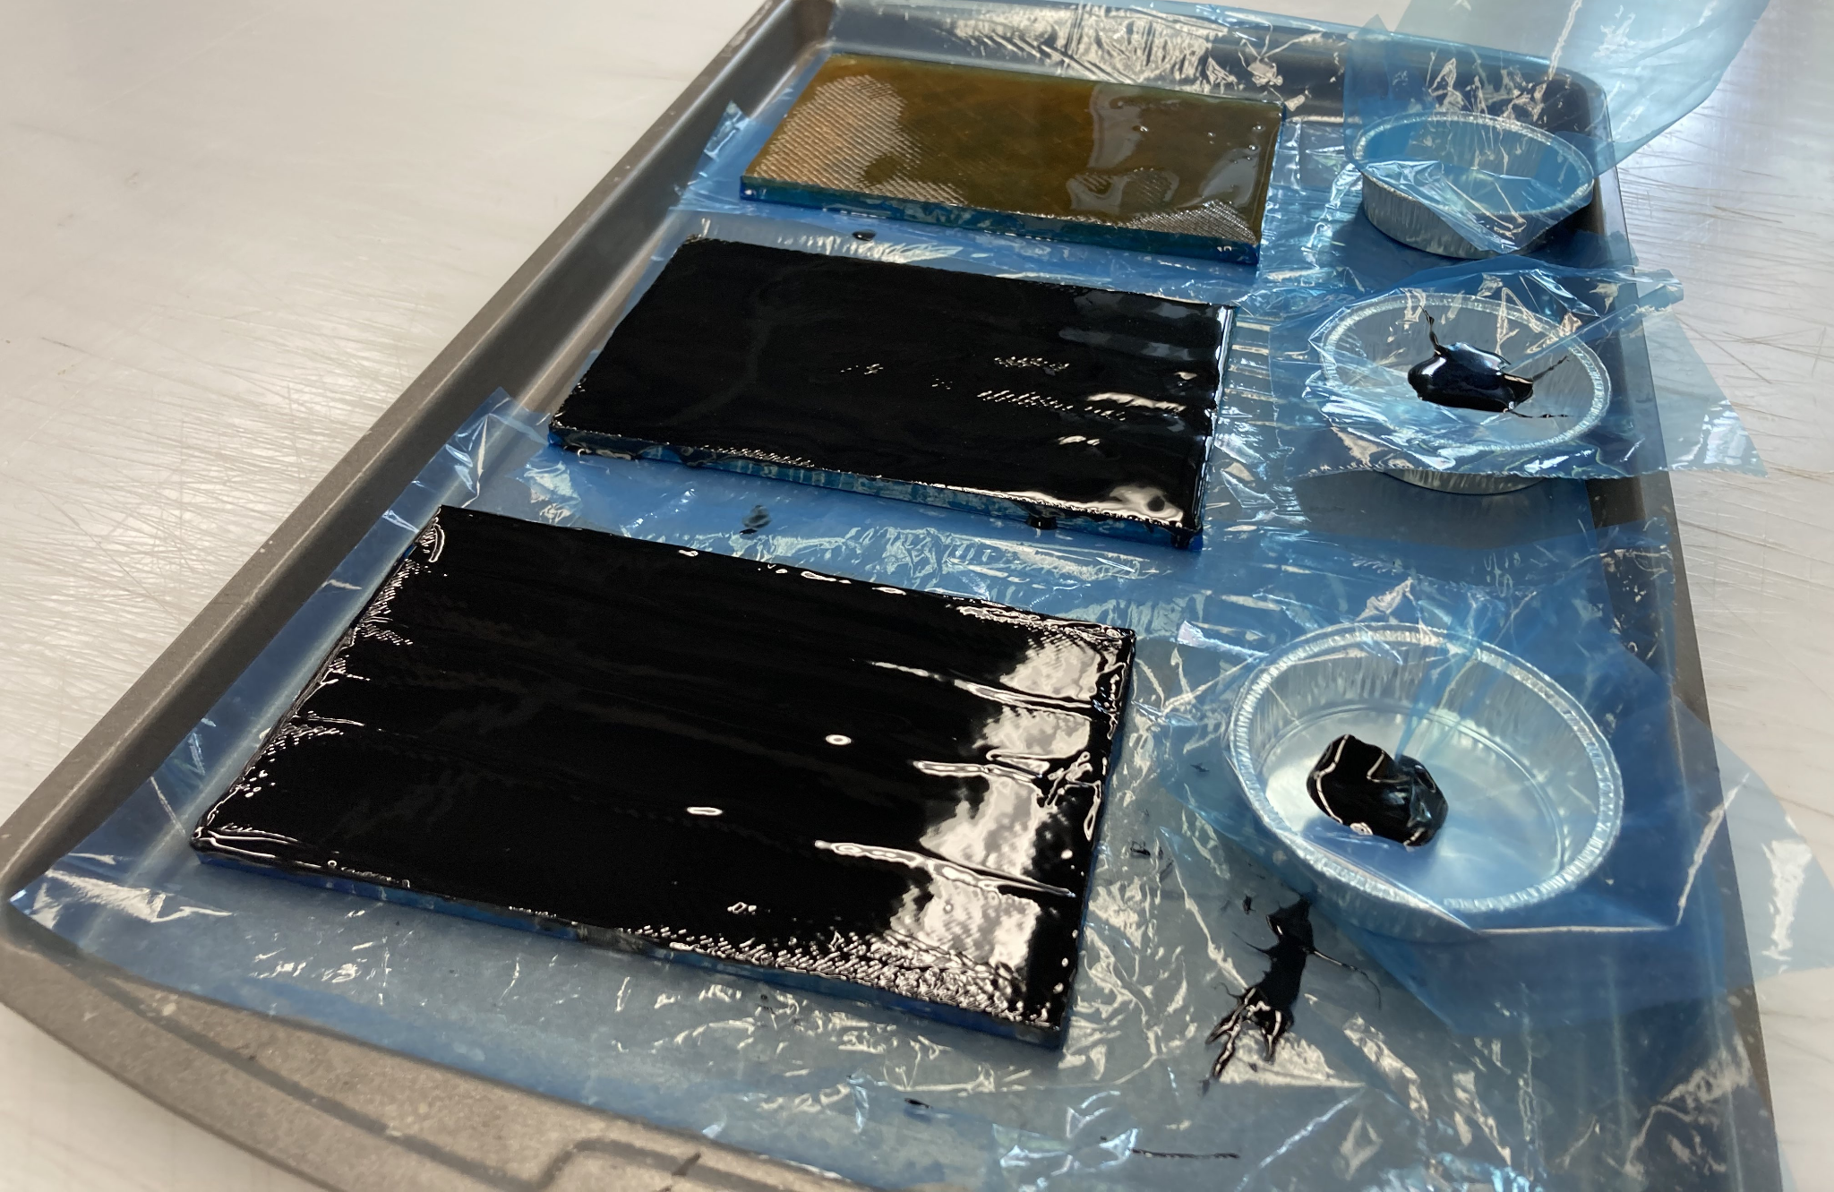
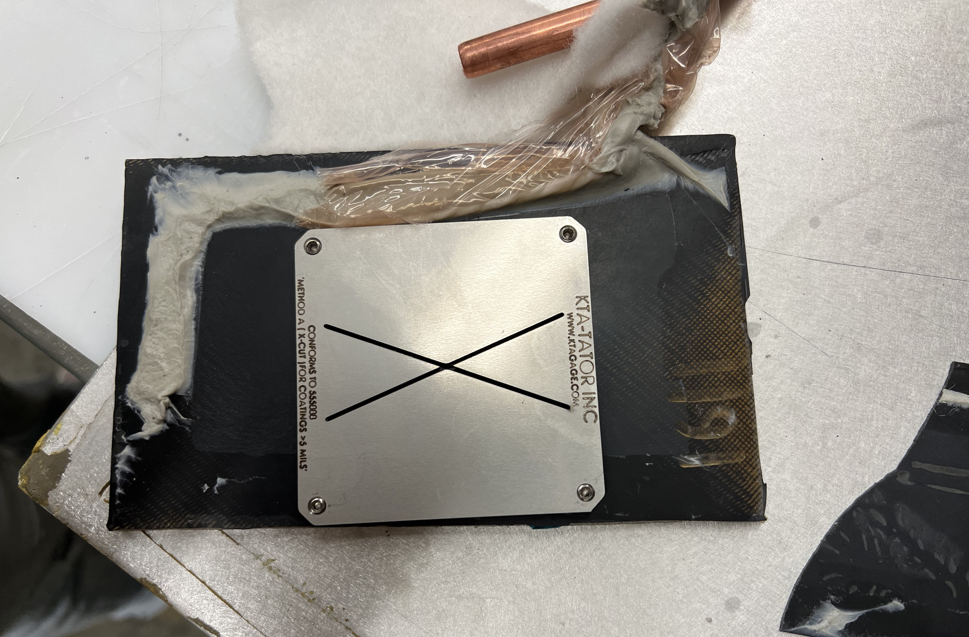
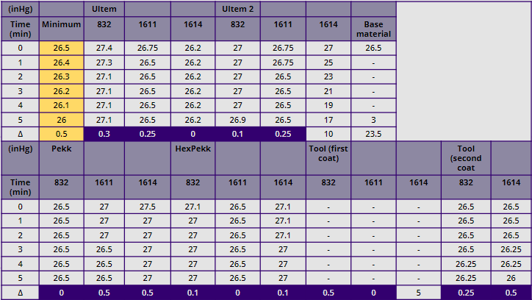
Hexcel - 3d Printed Tool Manufacturing Process Investigation for VARTM Process
Alexander Massie, Andrew Tong, Catherine Do, Johnny McKinley, Wyatt Markgraf
What is VARTM?
Vacuum-assisted resin transfer molding (VARTM) is a composite manufacturing process where liquid resin is drawn through a dry reinforcement under a vacuum bag with atmospheric pressure.The use of vacuum allows the resin to spread throughout the mold, impregnating the fibers without the presence of air. The resin is then cured, usually through the application of heat.
Why 3D printed molds?
Most current metal molds are produced with subtractive manufacturing techniques such as CNC machining. These methods are often expensive, completed through third-party vendors, and limit design features. Due to these factors, Hexcel is exploring the use of additive manufacturing (AM) to make rapid prototype molds. Our main objective for this investigation was to research and test the viability of AM materials and surface top coats for use in VARTM processes.
Materials chosen needed to withstand service temperatures up to 150°C, with good vacuum integrity (<0.5 inHg lost in 5 min), and a smooth surface finish.
Methods
Results
Vacuum Integrity Testing
All tested surface coats found some success on the coupon level with vacuum integrity. Because of this, all three coatings were used on larger scale tools to test the coatings on complex geometries.
Vacuum tests on the larger tools found the 1611 and 832HT coatings to be the easiest application, with the 1614 resin having significantly less viscosity during application, leading to poor surface integrity post cure. The 1611 and 832 coatings were minimally invasive on the porous structure of the ULTEM 1010, with the 832 having less than ¼” of penetration and 1611 having less than 1/16” penetration.
Figure 2. Complex geometry tool during 832HT surface coating (left), Vacuum integrity testing (right)
Discussion/Conclusion
We found all 3 high temperature surface epoxies to be viable but some with more ease than others. Notably, the BJB materials 1611 held vacuum with only 1 coat followed by post cure, while 1614 and 832HT required minimum of 2 coats depending on the tool. The Ultem 1010 filament proved to withstand temperatures up to 450℃ before degradation as shown by TGA, and if the tools are printed in a top down orientation, the tool is much less porous allowing vacuum to hold much easier. Sanding was necessary for all surface coats as they often cured in an uneven way and was also necessary to maintain tolerances.
Another goal of this project was to determine how cost effective 3D printing tools are compared to traditional aluminium machined tools. To make the complex geometry tool (see figure 2), this would have cost roughly $7,250 to be machined from 6060 T6 aluminium at a shop in Kent WA. Whereas printing with Ultem 1010 would require a high temperature 3D printer costing $15,000-$100,000 and roughly $1,000 worth of filament ($200/kg). After the initial investment of a high temp. 3D printer, tools could be printed at a cheaper cost with quicker turn arounds. Typical lead times are a few weeks from a machine shop whereas 3D printed tools could be done in several days.
Figure 1. Left to right: ULTEM Coupons; epoxy coating; vacuum integrity testing; tape testing.
ULTEM 1010 coupons were coated with three different epoxies using the technical data sheet (TDS) guidelines for curing. Virgin and carbon fiber filled SLS manufactured PEKK were also coated..
The cured coupons were sanded and tested for vacuum integrity using a vacuum apparatus. TGA and DSC were performed to ensure no further curing was necessary. The vacuum leakage was monitored for 5 minutes, with the passing threshold set at a maximum vacuum loss of 5inHg over 25 minutes. Tape testing was then conducted on the coupons to verify the adequacy of the epoxy-surface bond.
Upon assessing the vacuum integrity of the coupons, the molds were coated with the most suitable epoxies based on the porosity of the molds. The coated molds were subsequently cured and sanded.
Acknowledgments
Table 1. Successful (Purple) and failed vacuum integrity tests. highlighted values describe (vacuum lost/5 minutes)
Industry Mentors
Tim Carlson - HEXCEL R&T, Lead Capstone Mentor
Art Bzowka - HEXCEL, Lead Tech
UW Resources
Alex Gray - UW Composites lab
Carter Beamish - UW Undergraduate lab coordinator
Thermal Testing
Laboratory TGA tests were conducted to verify the thermal stability of all materials (both tooling base and surface coat). TGA results for ULTEM 1010, PEKK, and all three surface coats were consistent with designer specifications with material stability maintained well above 150℃.
Additionally DSC tests were conducted on surface coating materials to evaluate degree of cure. Results from DSC were consistent with fully cured coatings.

