Slide 1
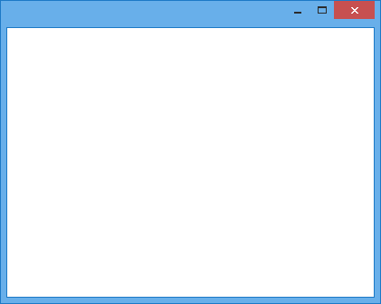
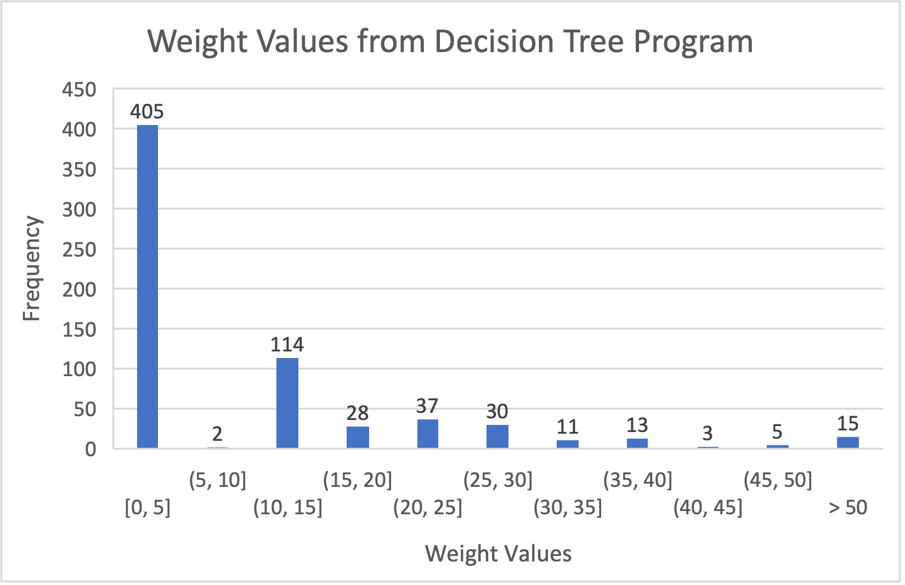
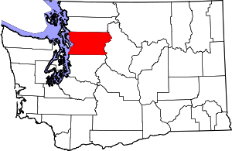
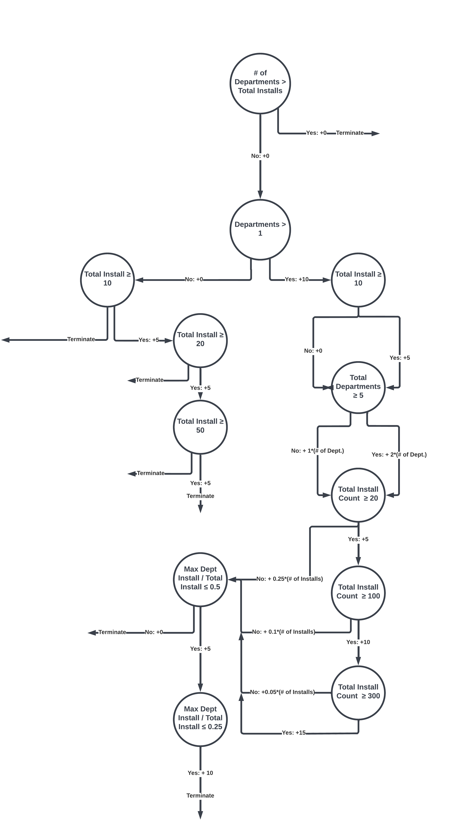
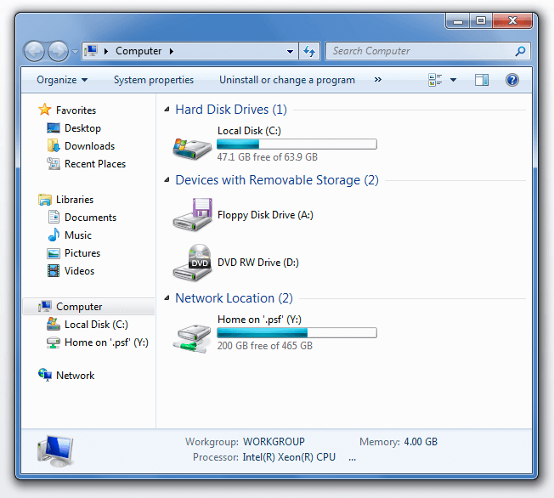
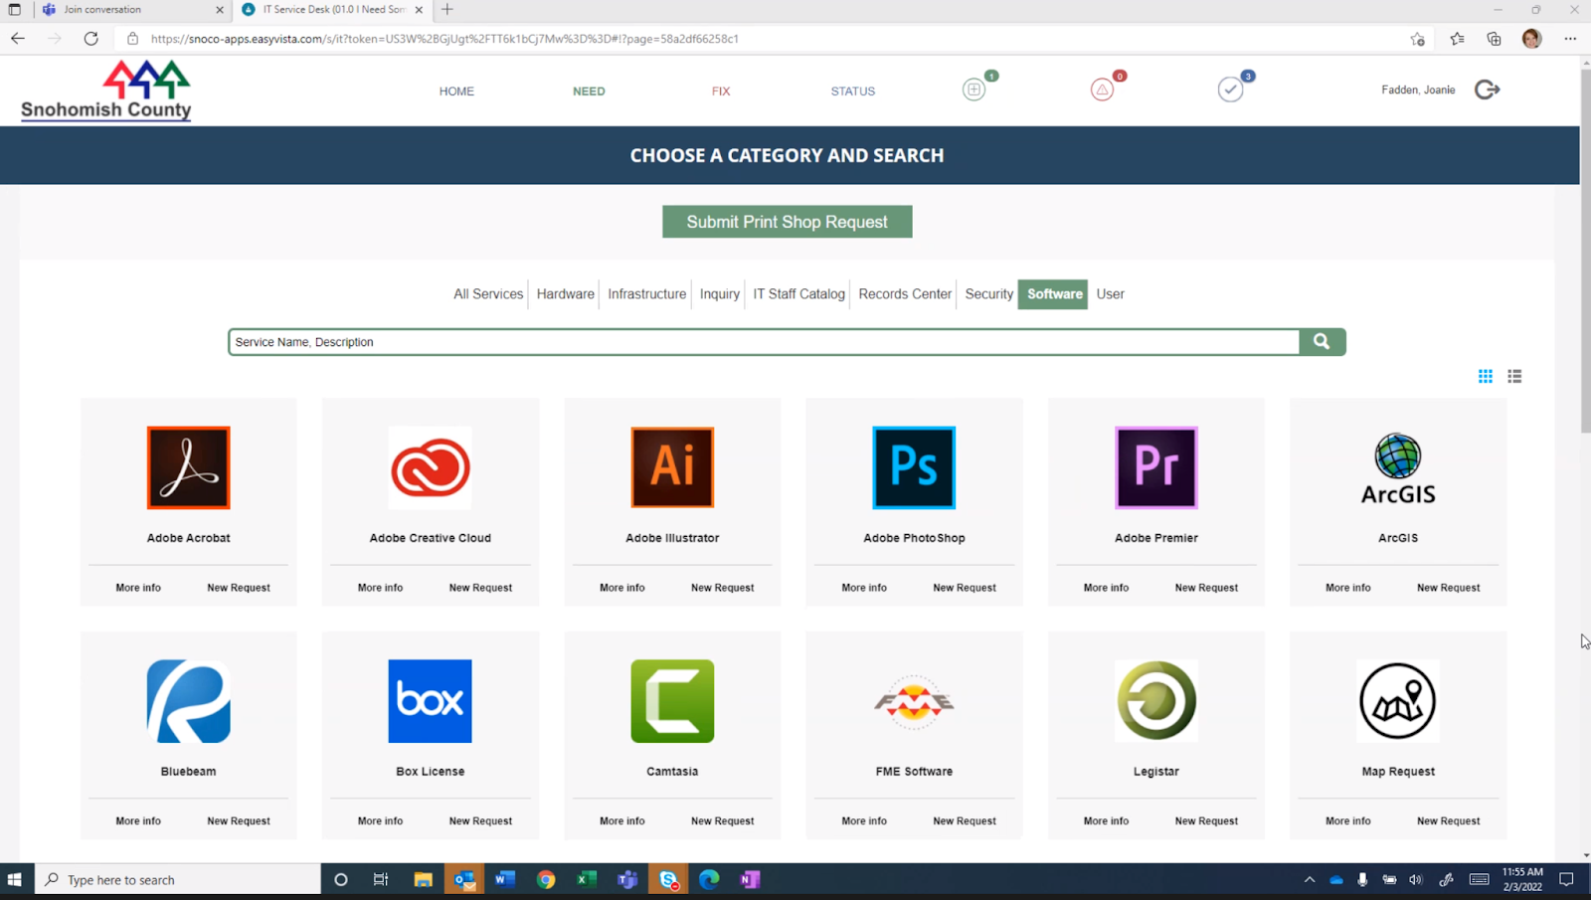
Retail Software Database Integration
Sahana Sundar | Nick Shawger | Kyle Sledge
Sponsors: Joanie Fadden, Viggo Forde Faculty Adviser: Patty Buchanan
What is Snohmish County?
Goals
Implementation
← The local government of this region!
It is made up of:
3500 Employees
27 departments (Public Works, Roads, IT, Police etc.)
Enhance the use of Easy Vista by creating a menu of highly utilized software products on the app
Categorize these software products → employees usually come in with a task instead of a specific software name
Develop a new assessment that would allow Snohomish County to pre-package newly introduced software with projected high utilization in the future
Created decision tree on paper
Automate in Python
Assign Weight Values
Problem
7200+ installations of software products on 3500+ workstations
Challenging for county employees to know what’s currently in the system, no searching functionality
Several duplicate licenses
Requests take 10 days to process and upwards of 45 days if procurement of software product is needed
Red circle denotes over 60% of total software applications having a weight value of, or near, zero, meaning they are under-utilized.
Green circle represents software applications with a higher utilization.
How do we figure out which software products are the most utilized?
Decision Tree
Results
Our final list of weight assignments matched the software utilization of Snohomish County
Snohomish County IT chose 15 points as the ideal cutoff value to consider a software product to be added to Easy Vista
142 software products with 15+ points → Snohomish County narrowed this down to 62 products to add to Easy Vista
Capstone team created an initial list of keywords to start categorizing these 62 products
Created a preliminary test to add software products with a projected high utilization (15+ points based on number of department and installations) to Easy Vista
Psst….We have a few products listed on a Service Management software called EasyVista, which allows employees to directly request licenses we have in the county. This makes them super easy to manage and we want to add more products to EasyVista!
Data Pre-Processing
Clarifying Assumptions
We asked our sponsor how they would deal with competing scenarios.
Ex: Which is more valuable to include on EasyVista, a software with multiple departments and fewer installs or a software with one department and many installs?
Number of Installations at Each Iteration of Pre-Processing
Lansweeper software pulled out all the installed products on SnoCo’s network
SnoCo manually removed device drivers and unwanted products
Removed a second round of unwanted products, consolidated different versions of the same product
“The 2022 UW Capstone student team assigned to Snohomish County impressed the IT leadership with their ability to distill a complex, elusive and costly challenge into a simplified resolution. They brought clarity, process and logic to an outdated process.”
~ Viggo Forde (Director of IT)
Savings
The Capstone Team would like to thank our sponsors Viggo Forde, and Joanie Fadden as well as our advisor Dr. Patricia Buchanan for their support throughout this project.
$70,000 /
year
175 employee hours / year
Reduce Frustration
Start Projects Sooner

